Slide 1
Northwind & Contoso
A shared vision.
A strong partnership.
Katie Jordan| March 2014
Exclusive Partner Agreement Analysis
Notes:
Executive Summary
Contoso and Northwind have a long and trusted relationship that spans more than three decades.
They share core values and a vision of the future that has benefited both companies over the years and will continue to in the future.
A sales analysis from 2013 showed that 42.5 percent of Northwind electronics sales were of Northwind-brand products created by Contoso.
A multiyear analysis showed that while Northwind sales have remained relatively steady since 2007, Northwind brand products created by Contoso have made up a steadily increasing share of those sales.
Customer research conducted in early 2013 determined that consumer trends are favorable to Northwind/Contoso products, hitting a sweet spot that consumers are looking for: innovative, good-quality products for a good price from companies they know and trust.
With exciting sustainability programs and new, innovative products on the horizon, a renewal of the exclusive Northwind/Contoso partnership will clearly benefit both companies.

Slide 2

Agenda
History
Shared Vision
Sales Analysis
Customer Research
Sustainable Practices
New Products
Sales Projections
Notes:
Speaker Notes
This talk will cover a number of aspects of the Northwind and Contoso partnership, as follows. By the end of this presentation, you’ll understand the full scope of the relationship.
History
Vision
Sales Analysis
Customer Research
Sustainable Practices
New Products
Sales Projections

Slide 3
Growing our businesses together A Partnership strengthened with time
Annual Revenue ($Millions)
Nov 1974
NC-012
Music Center
Mar 1987 NC-113
22” Television
July 2003 NC1524
Surround Speakers
Nov 2012
NC-34LT
Smart HDTV
Notes:
Speaker Notes
Contoso and Northwind have a long and trusted relationship that spans more than three decades.
Jack Barlow and Joe Schmidt meet in Joe’s Northwind store in Cleveland, Ohio, on August 1, 1974.
Contoso produced the first Northwind-brand integrated music center in November 1974.
In 1975, Northwind became known for TVs when it released the Contoso-produced CR-113.
In 1983, Northwind/Contoso released NC-S175 Home Theatre System.
June 1989: Northwind/Contoso released NC-S175 Speakers.
April 1997: Release of the NC-SR34 Large Screen LCD TV.
July 2003: NC1524 Surround-Sound Speakers.
November 2012: NC-34LT Smart HDTV.

Slide 4



Partnership Locations
Boston, MA
Chicago, IL
San Francisco, CA
Notes:
Speaker Notes
In 1974, we had one office in Cleveland, Ohio
Now we have 14 cities with joint Northwind & Contoso storefronts
That number will grow to 20 by 2018

Slide 5

Shared values
Innovation & responsibility
Contoso is the only manufacturing company using 75% Green Energy.
Notes:
Speaker Notes
On July 1, 1976, Joe Schmidt and Jack Barlow had a meeting in the back room of the original Northwind store.
That day, they decided to establish the shared values of their companies.
They arrived at three words: Innovation and Responsibility.
Since then, both Northwind and Contoso have grown into multinational companies.
Neither organization has forgotten the values that the companies were founded on.

Slide 6
Northwind Revenue 2013
47% of overall sales from Contoso products
+6% - Flat screen TVs
+8% - Stereo
26%
21%
Notes:
Speaker Notes
Focusing on current numbers, we can see the Northwind/Contoso relationship is stronger than ever.
In 2011, Northwind’s overall worldwide sales topped $354 million.
Of that, 36.7 percent were from the sale of electronics.
In that category, 42.5 percent of Northwind sales were of Contoso products.
Due to Northwind’s exclusive contract with Contoso, Northwind saw a profit margin from Contoso-produced products that was 17.5 percent higher than sales of similar products manufactured by other brands.
In the flat-screen TV category, Northwind-brand TVs created by Contoso comprised 47.2 percent of Northwind sales, an increase of 5.4 percent compared to 2010.
In the stereo category, Contoso-produced Northwind-brand stereos made up 41.4 percent of Northwind sales, a 7.8 percent increase over 2010.

Slide 7
Growth in Contoso sales
2013 3D TV Contoso-driven sales
Q1
Q2
Q3
Q4
Notes:
Speaker Notes
An analysis of overall Northwind sales in 2011 shows that Contoso-produced Northwind brand products are making up an increasing share of overall sales.
A prime example is 3D TVs, which saw a marked increase to 60% of overall Northwind 3D TV sales in 2011.
If we look at 3D TV Sales over 2010 and 2011, we can clearly the overall trend of customers increasingly choosing Northwind brand 3D TVs.
In the first half of 2010, Contoso brand 3D TVs made up just 27% of overall 3D TV sales.
However, by the end of the first half of 2011, that had increased to 42%.
By the end of 2011, it had increased to just over 60%.

Slide 8

Our loyal customers
Sales up by 13%
Brand loyalty 80%
Environmental award
Notes:
Speaker Notes
Customer survey (Jan. 2012): A customer research survey, co-sponsored by Contoso and Northwind, was conducted at the beginning of 2012.
Survey asked consumers why they chose to buy Northwind-brand electronics over other name brands.
Phrases that emerged most often from consumers: “value” (26 percent) , “trusted” (23 percent), “quality” (21 percent), and “innovative” (19 percent).
All of these phrases map back to both companies’ core values, proving that Northwind’s and Contoso’s shared approach to business is paying off.
Longer-term trends: Customer research to determine why consumers were increasingly choosing the Northwind brand.
Worldwide recession that began in 2008 has been a major factor.
Consumers have less discretionary income.
Turning to trusted brands that are perceived to be good quality yet still a good value for the money.
Northwind/Contoso products hit the sweet spot that consumers are looking for innovative, good-quality products for a good price from companies they know and trust.
Sustainability: Customer surveys have also shown that consumers have become conscious about where they make their purchases, and they are increasingly choosing to buy from companies that they perceive as having values of honesty and integrity as well as sustainable manufacturing processes.

Slide 9

A commitment to the future

Slide 10
Commitment to sustainable practices
TV MANUFACTURED BY CONTOSO
CONTOSO REUSES AND RECYCLES 55% OF PARTS
TV BOUGHT BY CONSUMER
BROUGHT BACK TO NORTHWIND TO RECYCLE
Notes:
Speaker Notes
Since its beginnings, Contoso has been at the forefront of new ways to produce and distribute products that have a reduced environmental impact and a smaller carbon footprint.
In 2008, Contoso initiated a recycled materials program that set an ambitious goal: its products would be comprised of 25 percent recycled postconsumer content by 2015.
The latest figures from 2011 show that Contoso is on track to meet that goal, having increased its recycled materials to 17 percent from 12 percent in 2010.
A ground-breaking new program
Contoso is also excited to announce a ground-breaking new program that it is working on with Northwind: the Full-Cycle Program.
Contoso and Northwind will work together to manage the full customer life cycle from “cradle to cradle.”
In this model, products go from manufacturer to retailer to customer, then back to the retailer, then back to the manufacturer.
Product is disassembled, and parts are reused or recycled in the production of new products.
After an initial investment, this program has been projected to save Contoso 15 to 20 percent per year in manufacturing costs.
With the renewal of its contract with Contoso, Northwind ensures its participation in this innovative and noteworthy program and the potential for savings in manufacturing and distribution costs in the near future.

Slide 11
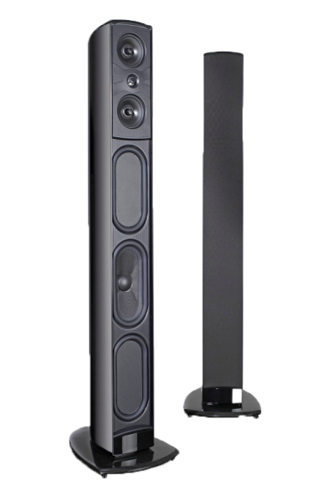
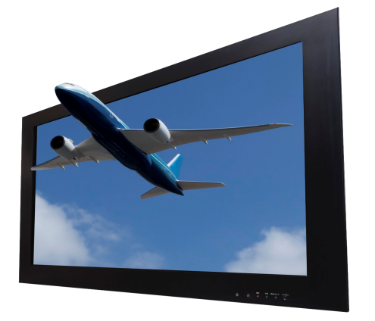
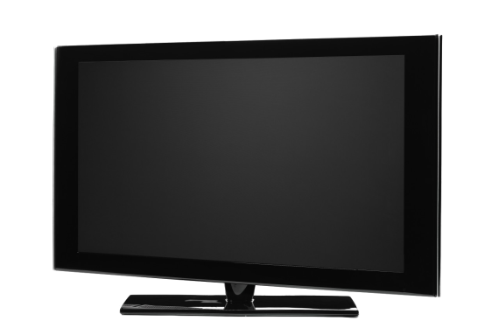
Commitment to advancing technology
Introducing new cutting-edge products in 2014-2015
Smart Television
3D Television
Wireless Surround Sound
Notes:
Speaker Notes
With Northwind support, Contoso research and development has produced some of the most innovative electronics products of the past 35 years.
While Northwind brand has always been known for good quality and value, in the next two years, Contoso plans to unveil a suite of high-end products that consumers may be accustomed to seeing only from upscale electronic brands.
Contoso products that are scheduled to launch in 2013 and 2014 include cutting-edge smart TVs, 3D TVs, true surround-sound stereo systems, and immersive home theatre packages.
Renewal of the Northwind/Contoso partnership will ensure that these products will be available exclusively at Northwind retail outlets worldwide.
Sneak peek at NC-3DR4 Cinematic 3D TV
Immersive 3D experience
Comes in 47” and 55”
LED backlighting
True surround-sound speakers
Full HD 1080p resolution

Slide 12
Northwind & Contoso
A shared vision. A strong partnership.
Thank you!

